Slide 1

Subject Code: SCS1301 Subject Name: Operating System UNIT III Faculty Name: Dr. P. AJITHA

Slide 2
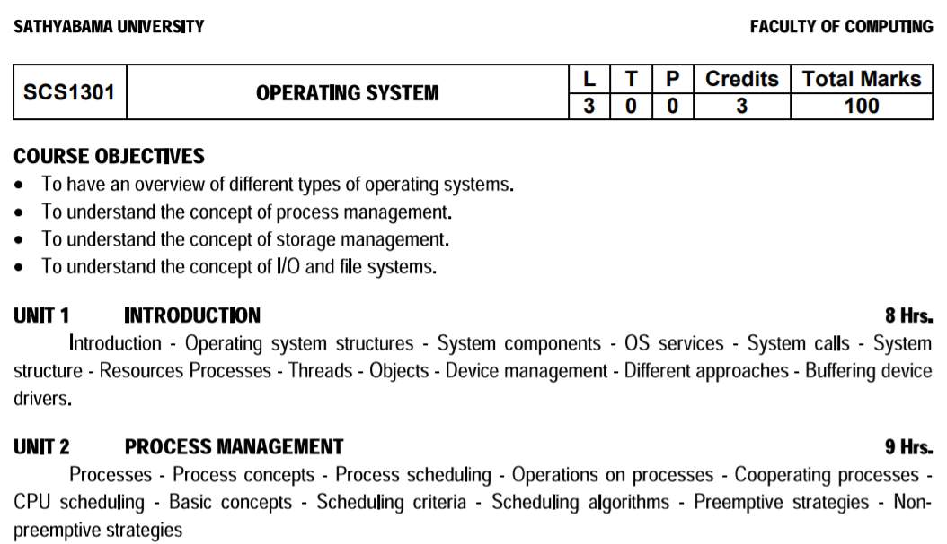

Slide 3
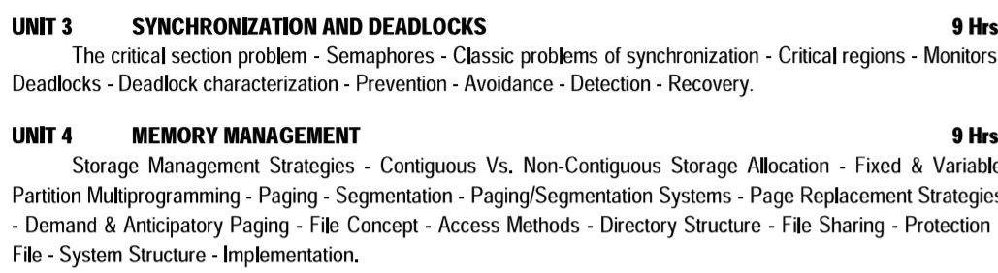

Slide 4
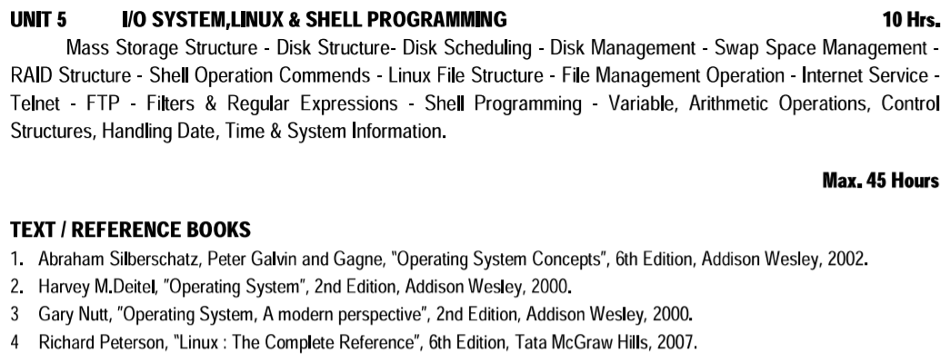

Slide 5
Course Outcome
Comprehend knowledge about Operating system components and services.
Apply knowledge of process scheduling algorithms for a given context
Analyze process synchronization and deadlock Conditions
Construct the process of Mapping logical address to physical address
Design appropriate strategies for Paging and Segmentation
Develop Real Time Applications Based on Linux Shell Programming.

Slide 6

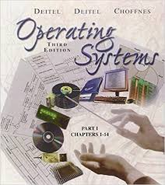

Recommended Books:

Slide 7
Roadmap to UNIT III
Deadlocks - Deadlock characterization - Prevention - Avoidance - Detection - Recovery.

Slide 8
Deadlock Problem
A set of blocked processes each holding a resource and waiting to acquire a resource held by another process in the set.
For Example System has 2 tape drives.
P0 and P1 each hold one tape drive and each needs another one, semaphores A and B, initialized to 1
P0 P1
wait (A); wait(B);
wait (B); wait(A);

Slide 9
Deadlock -Bridge Crossing Example

Slide 10
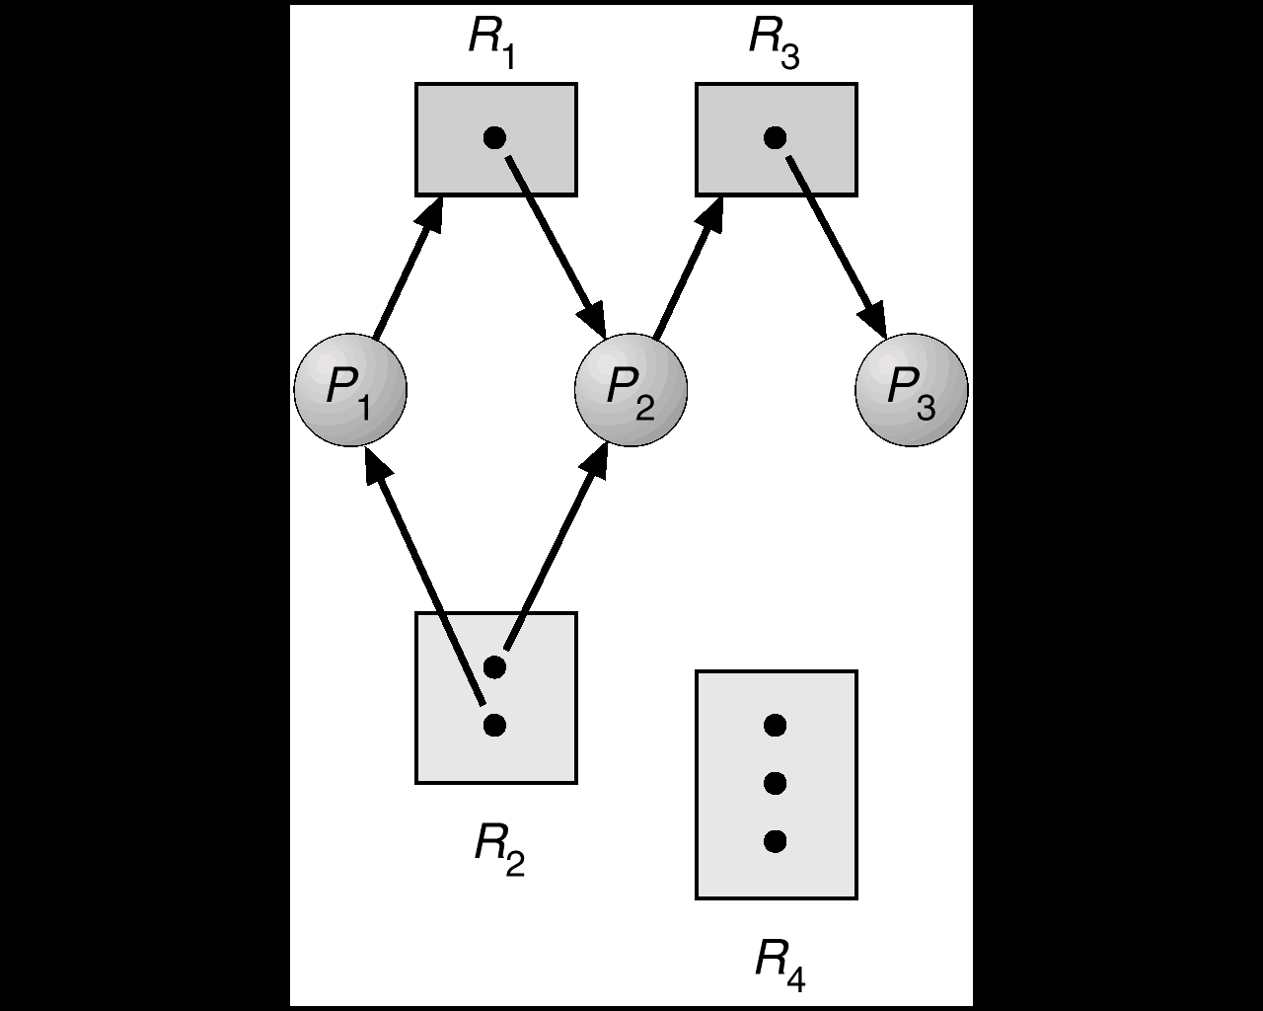
System Model
Resource types R1, R2, . . ., Rm.
Each resource type Ri has Wi instances.
Each process utilizes a resource as follows:
request
use
release

Slide 11
Deadlock Characterization
Deadlock can arise if four conditions hold simultaneously.
Mutual exclusion: only one process at a time can use a resource.
Hold and wait: a process holding at least one resource is waiting to acquire additional resources held by other processes.
No preemption: a resource can be released only voluntarily by the process holding it, after that process has completed its task.
Circular wait: there exists a set {P0, P1, …, Pn} of waiting processes such that P0 is waiting for a resource that is held by P1, P1 is waiting for a resource that is held by P2, …, Pn–1 is waiting for a resource that is held by Pn, and P0 is waiting for a resource thatis held by Pn.

Slide 12
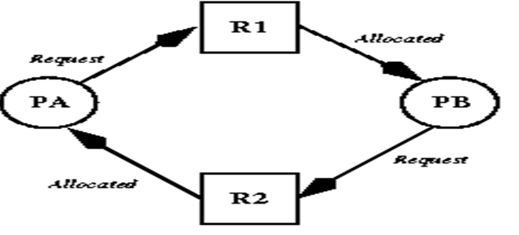
Hold and Wait

Slide 13
Resource-Allocation Graph
A set of vertices V and a set of edges E.
V is partitioned into two types:
P = {P1, P2, …, Pn}, the set consisting of all the processes in the system.
R = {R1, R2, …, Rm}, the set consisting of all resource types in the system.
Request edge – directed edge P1 → Rj
Assignment edge – directed edge Rj → Pi

Slide 14
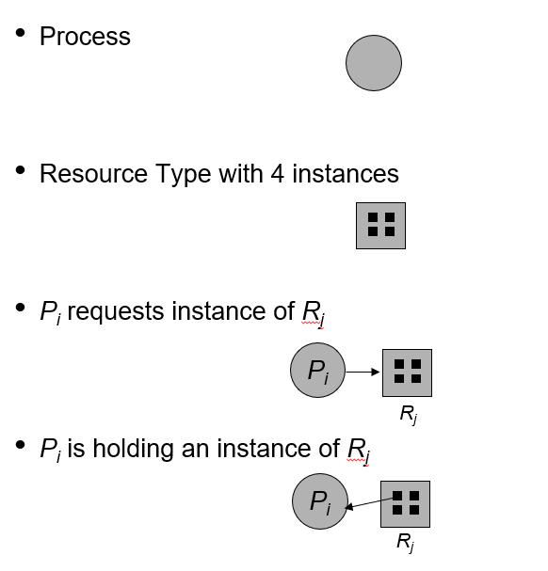
Resource-Allocation Graph

Slide 15
Resource Allocation Graph
The sets P, R and E:
P == {P1, P2, P3}
R== {R1, R2, R3, R4}
E == {Pl→ R1, p2→ R3, Rl→ p2, R2→ p2,R2→ Pl, R3→ P3}
Resource instances:
One instance of resource type R1
Two instances of resource type R2
One instance of resource type R3
Three instances of resource type R4
Process states:
Process P1 is holding an instance of resource type R2 and is waiting for an instance of resource type R1 .
Process P2 is holding an instance of R1 and an instance of R2 and is waiting for an instance of R3.
Process P3 is holding an instance of R3 .

Slide 16
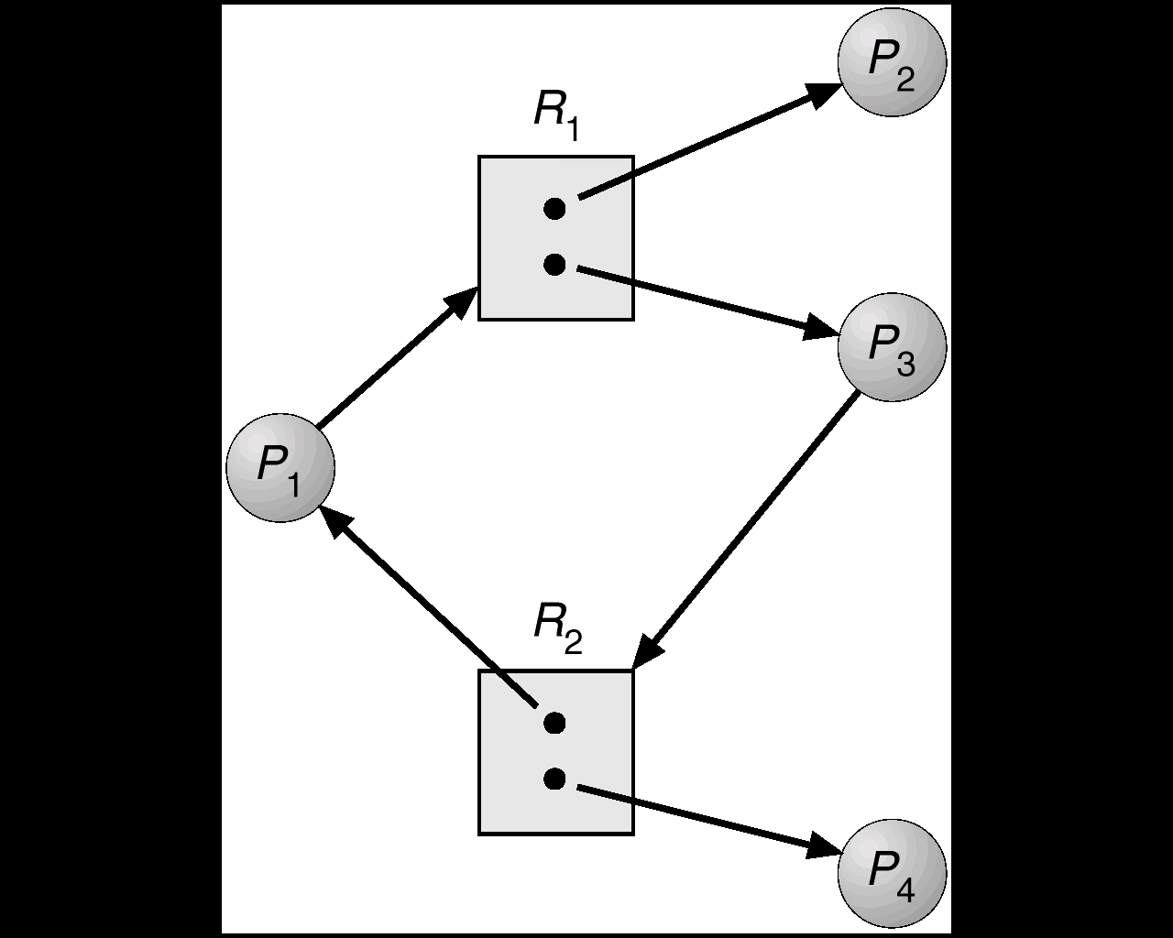
Resource Allocation Graph With A Cycle But No Deadlock(p2,p1,p4,p3)
Basic Facts
If graph contains no cycles ⇒ no deadlock.
If graph contains a cycle
if only one instance per resource type, then deadlock.
if several instances per resource type, possibility of deadlock.

Slide 17
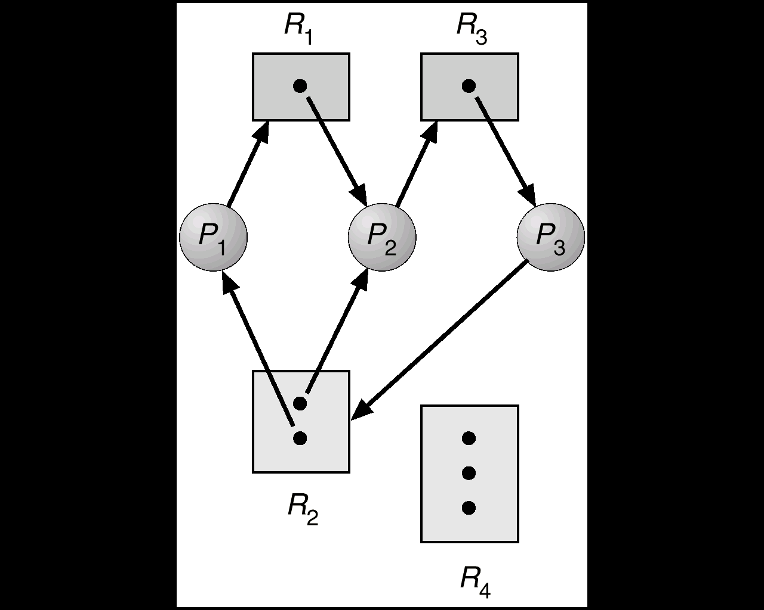
Resource Allocation Graph With A Cycle with Deadlock
Basic Facts
If graph contains no cycles ⇒ no deadlock.
If graph contains a cycle
if only one instance per resource type, then deadlock.
if several instances per resource type, possibility of deadlock.

Slide 18
Methods for Handling Deadlocks
Deadlock Prevention or Avoidance- Ensure that the system will never enter a deadlock state
Deadlock Detection - Allow the system to enter a deadlock state and then recover.
Ignore the problem and pretend that deadlocks never occur in the system; used by most operating systems,including UNIX.

Slide 19
Deadlock Prevention
Mutual Exclusion
a) Automatically holds for printers and other non-sharables.
b) Shared entities (read only files) don't need mutual exclusion (and aren’t susceptible to deadlock.)
c) Prevention not possible, since some devices are intrinsically non-sharable.
Hold and Wait
a) Collect all resources before execution.
Utilization is low
A Process that needs several popular resources may have to wait indefinitely, because at least one of the resources that it needs is always allocated to some other process.
Starvation possible.

Slide 20
Deadlock Prevention
No Preemption
a) Release any resource already being held if the process can't get an additional resource.
b) Allow preemption - if a needed resource is held by another process, which is also waiting on some resource, steal it. Otherwise wait.
Circular Wait
Number resources and only request in ascending order.
F (tape drive) = 1
F (disk drive) = 5
F (printer) = 12

Slide 21
Deadlock Avoidance
Requires that the system has some additional a priori information available.
Simplest and most useful model requires that each process declare the maximum number of resources of each type that it may need.
The deadlock-avoidance algorithm dynamically examines the resource-allocation state to ensure that there can never be a circular-wait condition.
Resource-allocation state is defined by the number of available and allocated resources, and the maximum demands of the processes.

Slide 22
Safe State
When a process requests an available resource, system must decide if immediate allocation leaves the system in a safe state. System is in safe state if there exists a safe sequence of all processes.
Sequence <P1, P2, …, Pn> is safe if for each Pi, the resources that Pi can still request can be satisfied by currently available resources + resources held by all the Pj, with j<i.
If Pi resource needs are not immediately available, then Pi can wait until all Pj have finished. When Pj is finished, Pi can obtain needed resources, execute, return allocated resources, and terminate.
When Pi terminates, Pi+1 can obtain its needed resources, and so on.

Slide 23
Basic Facts
If a system is in safe state ⇒ no deadlocks.
If a system is in unsafe state ⇒ possibility of deadlock.
Avoidance ⇒ ensure that a system will never enter an unsafe state.
Process Maximum(Tape) Allocated(Tape) Available Tape Drive in System
P0 10 5 3
P1 4 2
P2 9 2
Safe Sequence <P1,P0,P2>

Slide 24
Safe, Unsafe , Deadlock State

Slide 25
Resource-Allocation Graph Algorithm(one instance of each resource)
Claim edge P1→ R2 indicated that process P1may request resource R2; represented by a dashed line.
Claim edge converts to request edge when a process requests a resource.
When a resource is released by a process, assignment edge reconverts to a claim edge.
Resources must be claimed a priori in the system.

Slide 26
Unsafe State In Resource-Allocation Graph

Slide 27
Example formal algorithms
Banker’s Algorithm
Safety Algorithm
The algorithm for finding out whether or not a system is in a safe state.
Resource-Request Algorithm
Banker’s Algorithm
Multiple instances.
Each process must have a priori claim maximum use.
When a process requests a resource it may have to wait.
When a process gets all its resources it must return them in a finite amount of time.

Slide 28
Data Structures for the Banker’s Algorithm
Let n = number of processes, and m = number of resources types.
Available: Vector of length m. If available [j] = k, there are k instances of resource type Rj available.
Max: n x m matrix. If Max [i,j] = k, then process Pi may request at most k instances of resource type Rj.
Allocation: n x m matrix. If Allocation[i,j] = k then Pi is currently allocated k instances of Rj.
Need: n x m matrix. If Need[i,j] = k, then Pi may need k more instances of Rj to complete its task.
Need [i,j] = Max[i,j] – Allocation [i,j]

Slide 29
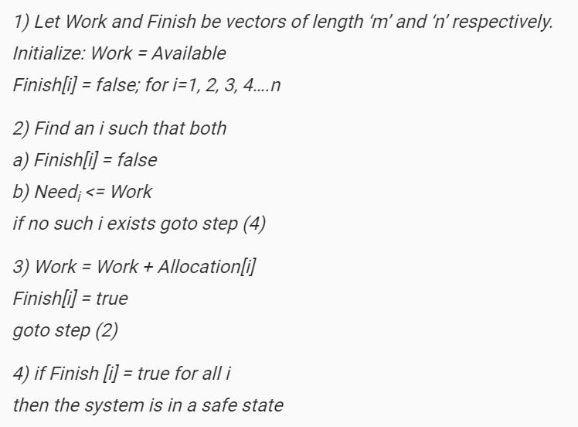
Safety Algorithm

Slide 30
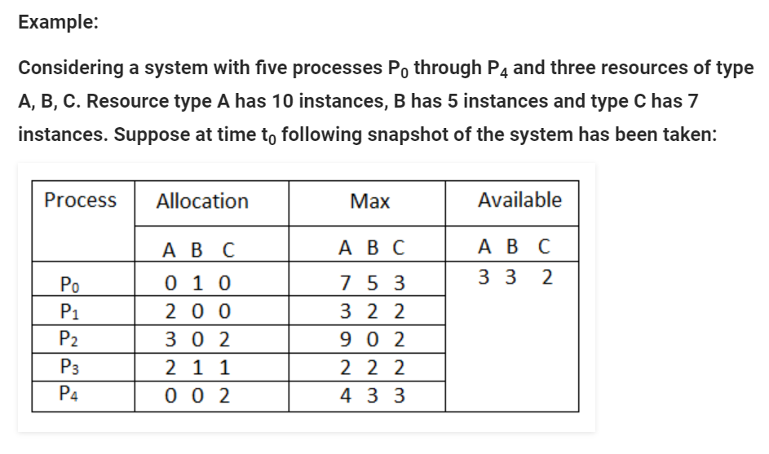
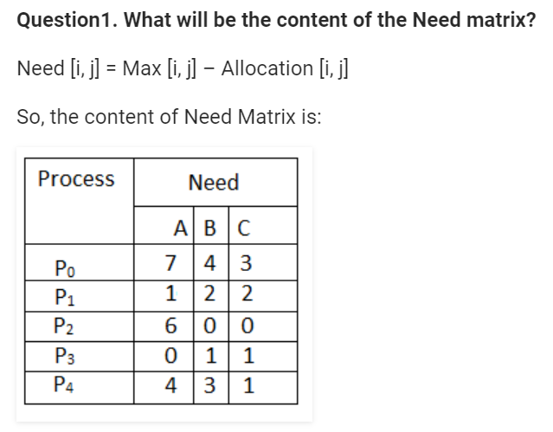
Banker Algorithm

Slide 31
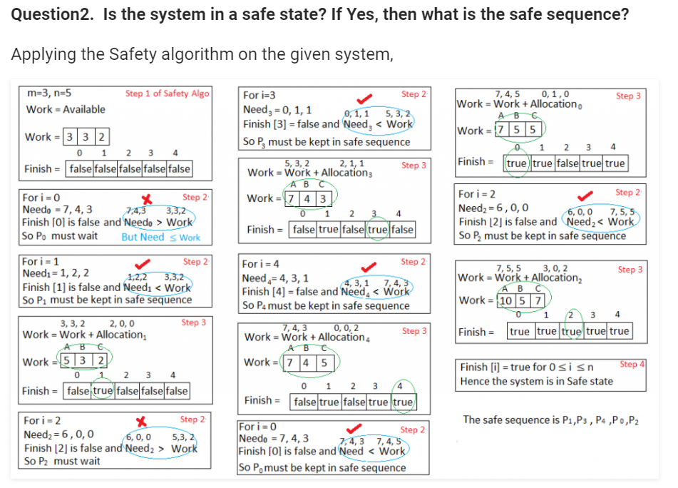

Slide 32
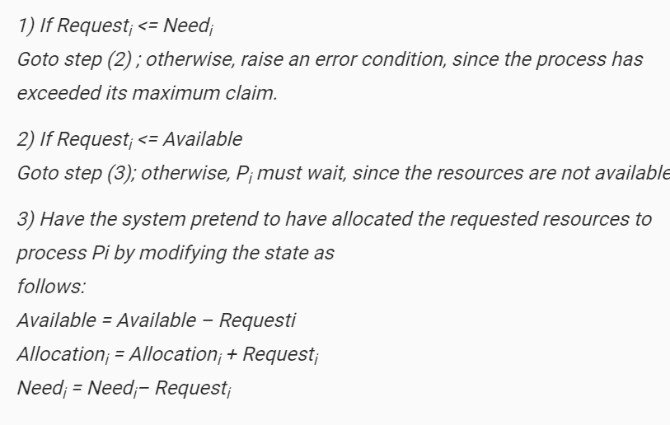
Resource-Request Algorithm for Process Pi [Allocat =5 , max=10, need=5, Req=2, Avail=6]

Slide 33
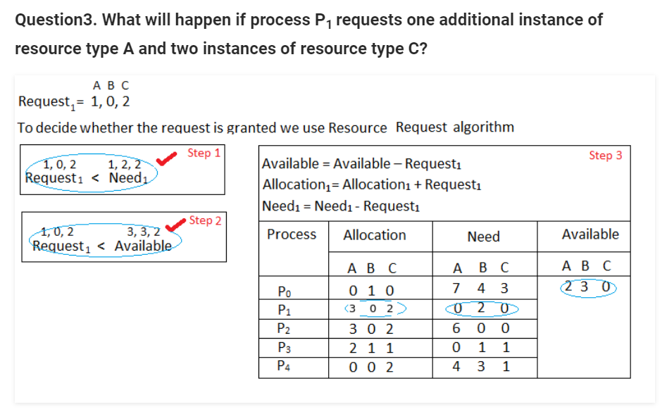
Resource-Request Algorithm for Process Pi

Slide 34
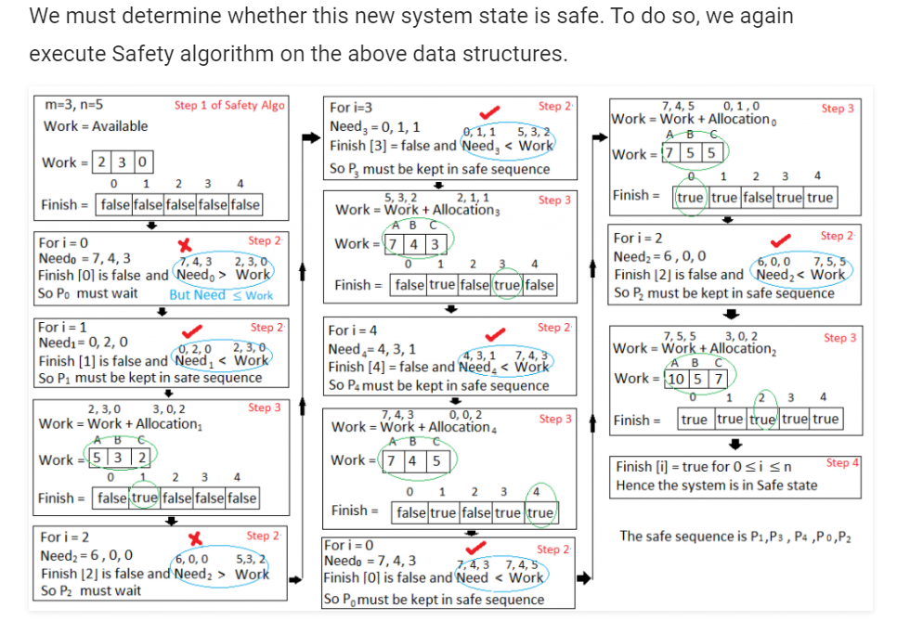
Resource-Request Algorithm for Process Pi

Slide 35
Deadlock Detection
Allow system to enter deadlock state
Detection algorithm
Recovery scheme
Single Instance of Each Resource Type
Maintain wait-for graph
Nodes are processes.
Pi → Pj if Pi is waiting for Pj.
Periodically invoke an algorithm that searches for a cycle in the graph.
An algorithm to detect a cycle in a graph requires an order of n2 operations, where n is the number of vertices in the graph.

Slide 36
Resource-Allocation Graph and Wait-for Graph

Slide 37
Several Instances of a Resource Type
Available: A vector of length m indicates the number of available resources of each type.
Allocation: An n x m matrix defines the number of resources of each type currently allocated to each
process.
Request: An n x m matrix indicates the current request of each process. If Request [ij] = k, then process Pi is requesting k more instances of resource type. Rj.

Slide 38
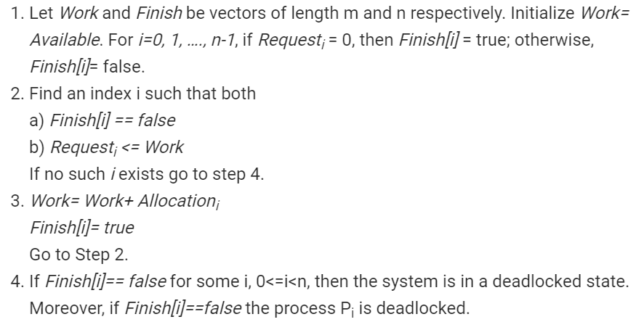
Detection Algorithm

Slide 39
Example of Detection Algorithm
Five processes P0 through P4; three resource types A (7 instances), B (2 instances), and C (6 instances).
SnapShot at Time T0

Slide 40
Sequence <P0, P2, P3, P1, P4> will result in Finish[i] = true for all i.
P2 requests an additional instance of type C.
Request of P2 is 0 0 1
Will result in Deadlock.

Slide 41
Detection-Algorithm Usage
When, and how often, to invoke depends on:
1. How often a deadlock is likely to occur?
2. How many processes will need to be rolled back?

Slide 42
Recovery from Deadlock: Process Termination
Abort all deadlocked processes.
Abort one process at a time until the deadlock cycle is eliminated.
In which order should we choose to abort?
Priority of the process.
How long process has computed, and how much longer to completion.
Resources the process has used. Resources process needs to complete.
How many processes will need to be terminated.
Is process interactive or batch?

Slide 43
Recovery from Deadlock: Resource Preemption
Selecting a victim – minimize cost.
Rollback – return to some safe state, restart process for that state.
Starvation – same process may always be picked as victim, include number of rollback in cost factor.

Slide 44
Monitors
High-level synchronization construct that allows the safe sharing of an abstract data type among concurrent processes.
type monitor-name = monitor
variable declarations
procedure entry P1 :(…);
begin … end;
procedure entry P2(…);
begin … end;

procedure entry Pn (…);
begin…end;
begin
initialization code
end

Slide 45
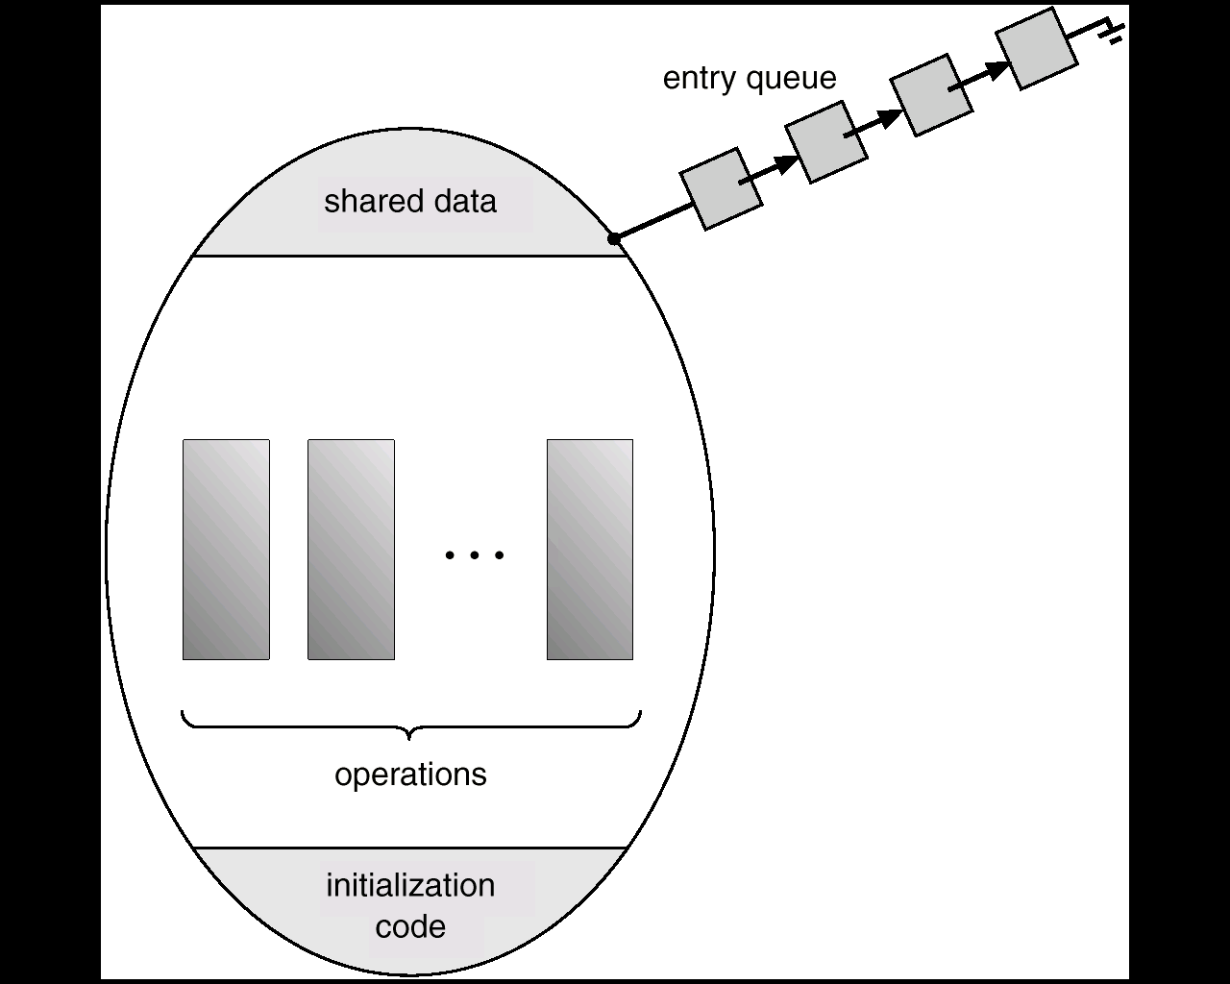
Schematic view of a Monitor
To allow a process to wait within the monitor, a condition variable must be declared, as
var x, y: condition
Condition variable can only be used with the operations wait and signal.
The operation
x.wait;
means that the process invoking this operation is suspended until another process invokes
x.signal:
operation resumes exactly one suspended process

Slide 46
Dining Philosopher Problem:
THINKING – When philosopher doesn’t want to gain access to either fork.
HUNGRY – When philosopher wants to enter the critical section.
EATING – When philosopher has got both the forks, i.e., he has entered the section.
Philosopher i can set the variable state[i] = EATING only if her two neighbors are not eating (state[(i+4) % 5] != EATING) and (state[(i+1) % 5] != EATING).
dp.pickup(i);
…….
Eat
…….
dp.putdown(i);

Slide 47
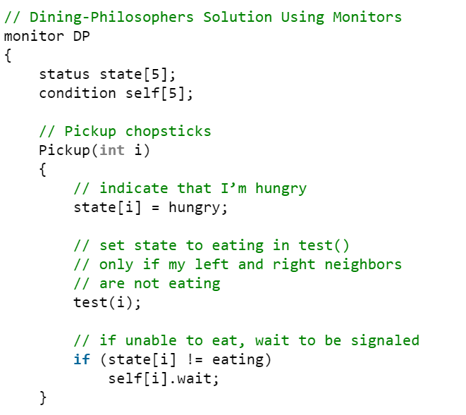
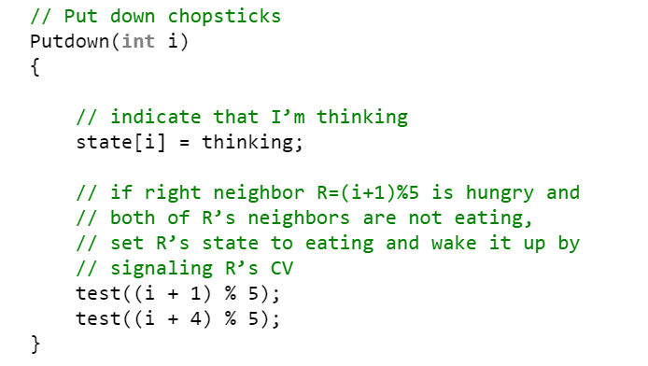

Slide 48
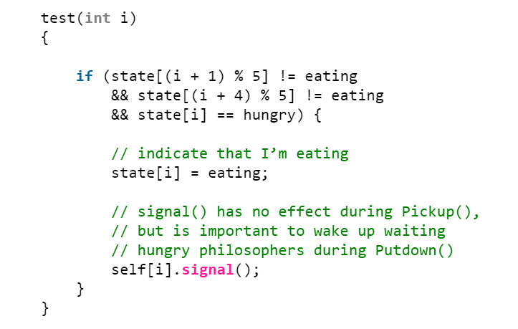
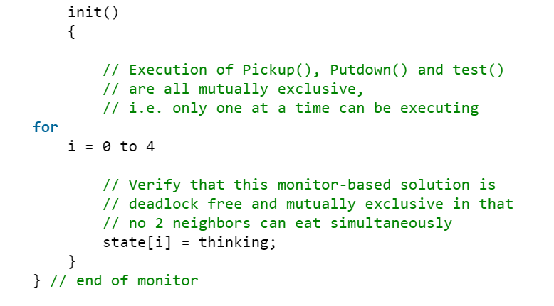

Slide 49
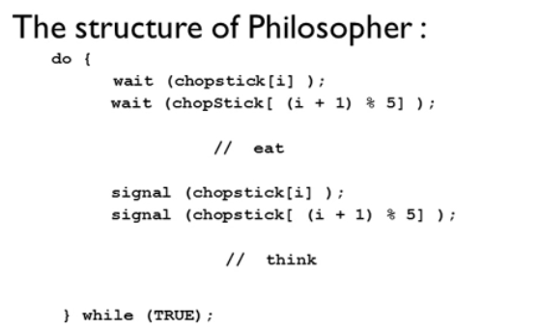

Slide 50
Process Synchronization:
Processes executing concurrently in the operating system may be either independent processes or cooperating processes.
Process is independent if it cannot affect or be affected by the other processes executing in the system.
Any process that does not share data with any other process is independent.
A process is cooperating if it can affect or be affected by the other processes executing in the system.
Clearly, any process that shares data with other processes is a cooperating process.

Slide 51
Cooperating Process(Producer Consumer Problem)
A producer can produce one item while the consumer is consuming another item.
To allow producer and consumer processes to run concurrently, we must have available a buffer of items that can be filled by the producer and emptied by the consumer
This buffer will reside in a region of memory that is shared by the producer and consumer processes.
Two types of buffers can be used:
Unbounded buffer
Bounded buffer
The unbounded buffer places no practical limit on the size of the buffer.
The consumer may have to wait for new items, but the producer can always produce new items.
The bounded buffer assumes a fixed buffer size.
In this case, the consumer must wait if the buffer is empty, and the producer must wait if the buffer is full.

Slide 52
Cooperating Process(Producer Consumer Problem)
Let us illustrate a shared-memory solution to the bounded-buffer problem.
The producer and consumer processes share the following variables:
#define BUFFER_SIZE 10
typedef struct {
............
}item;
item buffer [BUFFER_SIZE] ;
int in = 0 ;
int out = 0 ;
The shared buffer is implemented as a circular array with two logical pointers: in and out.
The variable in points to the next free position in the buffer; out points to the first full position in the buffer.

Slide 53
Cooperating Process(Producer Consumer Problem)
The buffer is empty when in == out; the buffer is full when ((in + 1) % BUFFER_SIZE) == out.
The producer process has a local variable nextProduced in which the new item to be produced is stored:
Producer Process
item nextProduced;
while (true)
{
/* produce an item in nextProduced */
while (((in + 1) % BUFFER-SIZE) = = out)
/* do nothing */
buffer[in] = nextProduced;
in = (in + 1) % BUFFER_SIZE;
in
out
0
4
1
3
2

Slide 54
Cooperating Process(Producer Consumer Problem)
The consumer process has a local variable nextConsumed in which the item to be consumed is stored
Consumer Process
while (true)
{
while (in == out);
/* do nothing */
nextConsumed = buffer[out];
out = (out + 1 ) % BUFFER_SIZE;
/*consume the item in nextConsumed */
This scheme allows at most BUFFER_SIZE - l items in the buffer at the same time.
in
out
0
4
1
3
2

Slide 55
Cooperating Process(Modified Producer Consumer Problem)
Add an integer variable counter initialized to 0.
Counter is incremented every time a new item is added to the buffer and is decremented every time, an item is removed from the buffer.
Modified Producer Process
while (true)
{
/* produce an item in nextProduced */
while (counter == BUFFER.SIZE)
; /* do nothing */
buffer[in] = nextProduced;
in = (in + 1) % BUFFER-SIZE;
counter++;
}
in
out
0
4
1
3
2

Slide 56
Cooperating Process(Modified Producer Consumer Problem)
Modified Consumer Process
while (true)
{
while (counter == 0)
; /* do nothing */
nextConsumed = buffer [out] ,-
out = (out + 1) % BUFFER_SIZE;
counter--;
/* consume the item in nextConsumed */
}
in
out
0
4
1
3
2

Slide 57
Problem in Cooperating Process
Both the producer and consumer routines are correct separately, they may not function correctly when executed concurrently.
The value of the variable counter is currently 5 and that the producer and consumer processes execute the statements "counter++" and "counter—" concurrently.
Following the execution of these two statements, the value of the variable counter may be 4, 5, or 6!
The only correct result, though, is counter == 5, which is generated correctly if the producer and consumer execute separately.
We can show that the value of counter may be incorrect as follows.

Slide 58
Problem in Cooperating Process
Counter ++ Counter –
register1 = counter register2 = counter
register1 = register1 + 1 register2 = register2 — 1
counter = register1 counter = register2
where register1 is a local CPU register where register2 is a local CPU register
T0: producer execute register1 = counter {registeri = 5}
T1: producer execute register 1 = register1 + 1 {registeri = 6}
T2: consumer execute register2. = counter {register2 — 5}
T3: consumer execute register2 = register2 — 1 {register 2 — 4}
T4: producer execute counter = register1 {counter = 6}
T5: consumer execute counter = register2 {counter = 4}

Slide 59
Race Condition
When several processes access and manipulate the same data concurrently and the outcome of the execution depends on the particular order in which the access takes place is called race condition.
To guard against the race condition, we need to ensure that only one process at a time can be manipulating the variable counter.
Hence processes must be synchronized.

Slide 60
The Critical Section Problem
Each process in a system has a segment of code called a critical section in which the process may be changing common variables,updating a table, writing a file etc.
The important feature of the system is that when one process is executing in its critical section, no
other process is to be allowed to execute in its critical section that is no two processes are executing in their critical sections at the same time.
The critical section problem is to design a protocol that the processes can use to co- operate.
Each process must request permission to enter its critical section.
The section of code implementing this request is the entry section.
The critical section may be followed by an exit section.
The remaining code is the remainder section.

Slide 61
General Structure of a Process
do
{
Entry Section
Critical Section
Exit Section
Remainder Section
}while(TRUE);

Slide 62
A solution to the critical section problem must satisfy the following three requirements:
Mutual exclusion: If a process is executing in critical section, then no other process can be executing in their critical section.
Progress: If no process is executing in its critical section and some processes wish to enter their critical sections, then only those processes that are not executing in their remainder sections can participate in the decision on which will enter its critical section next and this selection cannot be postponed indefinitely.
Bounded waiting: There exists a bound or limit on the number of times that other processes are allowed to enter their critical section after a process has made a request to enter its critical section and before that request is granted.

